Slide 1
The Oryol region. Opportunities for doing business

Slide 2
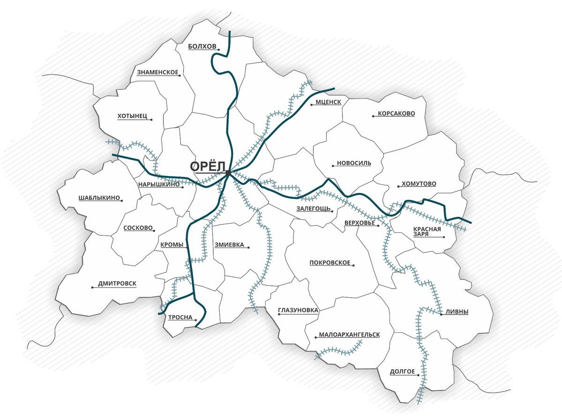
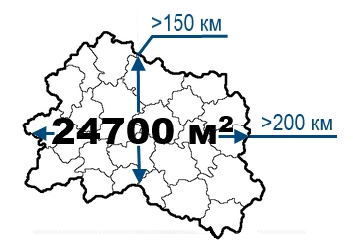
Territorial location
RIGA
1083 km
ST. PETERSBURG
1035 km
MOSCOW
382 km
The main railway lines
The main highways
KALUGA
207 km
«West-East» Riga – Voronezh – Saratov
М-2 Moscow – Oryol – Kharkiv - Simferopol
«North-South» Moscow-Kharkiv-Crimea-Caucasus
М-4 Moscow – Voronezh – Rostov-on-Don – Krasnodar – Novorossiysk
R119 Oryol – Tambov
MINSK
707 km
R120 Oryol – Bryansk – Smolensk
> 150 km
> 200 km
KIEV
560 km
KURSK
213 km
VORONEZH
330 km
BELGOROD
348 km

Slide 3
POPULATION
36,6%
700 276
PEOPLE POPULATION as of the date of 1 JANUARY 2023
55,4%
HIGHER EDUCATION
WORKING-AGE POPULATION
10
6
THOUSANDS GRADUATES ANNUALLY
HIGHER EDUCATIONAL INSTITUTIONS
28,4
19
PEOPLE/KM²
POPULATION DENSITY
36TH PLACE IN RUSSIA
SPECIALISED SECONDARY EDUCATIONAL
ESTABLISHMENT
4,0%
UNEMPLOYMENT (ON THE ILO)

Slide 4
Economic indicators
991,7
5,2
MILLION $
EXTERNAL TURNOVER
626,2 $
BILLION $
PER MONTH
GROSS REGIONAL
PRODUCT
861,5
AVERAGE WAGE
MILLION $
CAPITAL INVESTMENT

Slide 5
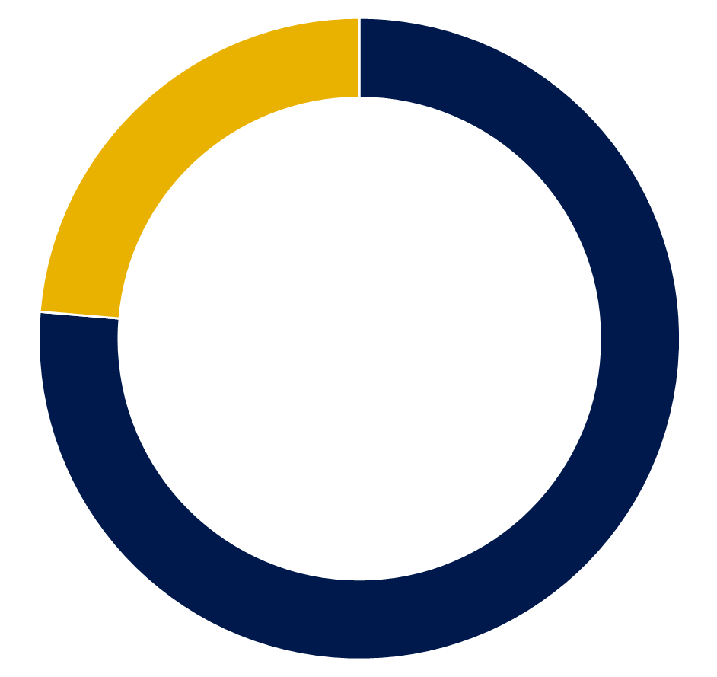
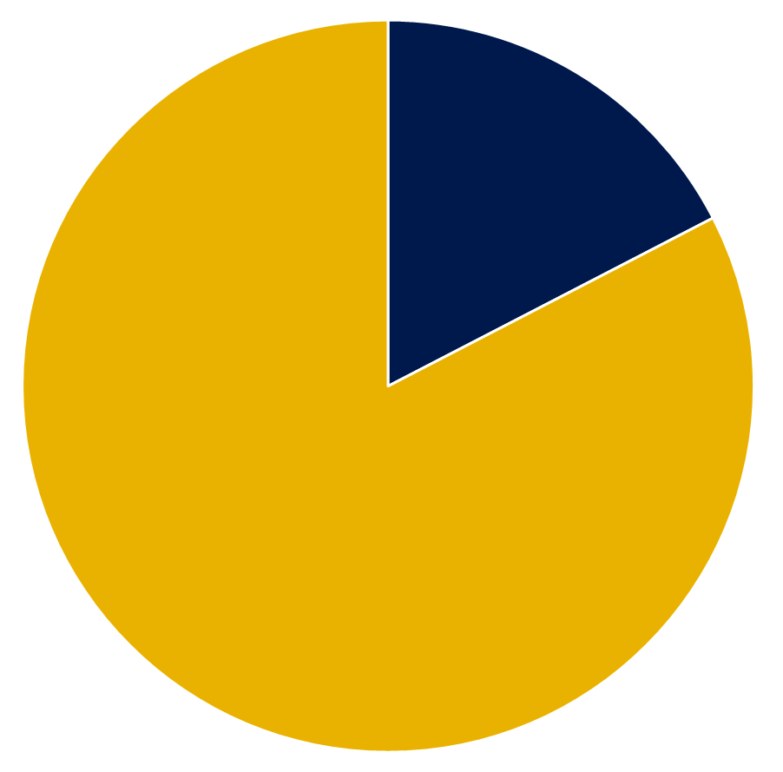
Agriculture
Sector leaders
28,7%
Priority areas:
share in GRP
meat and dairy cattle breeding
food and processing industry
poultry industry
grain market
bee-farming
agricultural lands
82,5%

Slide 6
Industrial production
Classification
Machinery
Instrument making
industry
pumping equipment
refrigerators
municipal equipment
agricultural equipment
fire-fighting equipment
lighting products
electrical products
cable product
semiconductor products
radio-diagnostic equipment
19,5%
share in GRP
Metallurgy
Production of
construction materials
fasteners
steelworks
meshy products
products based on
iron casting
welding materials
building ceramics
wall materials
prefabricated reinforced concrete
constructions for house building
finishing materials

Slide 7
PSEDA
«MTSENSK»
created within the boundaries of the monotown of Mtsensk
Types of benefits | Tax concession period for residents, years
 | 1 | 2 | 3 | 4 | 5 | 6 | 7 | 8 | 9 | 10
Profit tax
federal | 0 % from the moment of receiving profit |  |  |  |  | 2 %
regional | 0 % from the moment of receiving profit, 5 % starting from the 3rd year |  |  |  |  | 10 %
Property tax | 0 % |  |  |  |  | 1,1 %
Coefficient of mineral extraction tax | 0 |  | 0,2 |  | 0,4 |  | 0,6 |  | 0,8
Land tax | 0 % |  |  |  |  | In accordance with the regulatory legal act of the local public authority
VAT, works (services) | Accelerated VAT refund procedure
Insurance premiums | 7,6 %

Slide 8
Exemption from corporate property tax
Regional preferential rate of tax on profit of organizations
Planned territory of SEZ IPT «Oryol»
(industrial park «Zelenaya roshcha»)
for 10 years
0% → 5% → 13,5%
5 years
5 years
until the end of the SEZ
Exemption from land tax
Free customs zone
for 5 years
Land lease
from 40 000
rubles
per year
ha
Repurchase of lands
from 600 000
rubles
ha
182,1 hа, Mtsenskiy district of the Oryol region
9

Slide 9
Promising areas
PHARMACEUTICAL INDUSTRY
IT CLUSTER
MECHANIC ENGINEERING, METALWORK, METALLURGY
INSTRUMENT-MAKING CLUSTER
CLUSTERS
PRODUCTION OF CONSTRUCTION MATERIALS
TOURIST CLUSTER
CLUSTER К57 (GLONASS)
FOOD AND PROCESSING INDUSTRY
LIGHT
INDUSTRY
CLUSTER
LOGISTICS, DEVELOPMENT

Slide 10
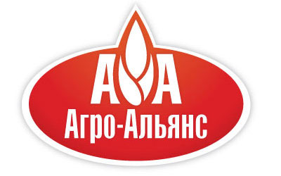
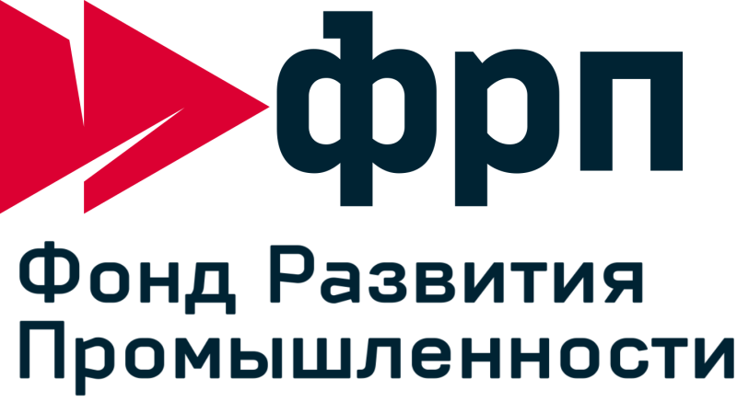
Our partners

Slide 11
GOVERNMENT OF THE ORYOL REGION
INVESTMENT PORTAL OF THE ORYOL REGION
INVEST-OREL.RU
302021, Oryol, Lenin square, 1
www.orel-region.ru

