Slide 1
LLC Scientific Production Enterprise «Etalon»®
Release granular mushrooms
and dried mixtures

Slide 2
Relevance of area
Tomsk region is the undisputed leader in reserves mushrooms - mushrooms available reserves of the order of 3500 tons.
Harvesting and processing of mushrooms are very complex and time-consuming process due to the abrupt seasonal volume growth of wild mushrooms and the need for fast processing in order to avoid spoilage.
Today mushrooms in human nutrition are pleasant flavoring only because of the contained in the cell walls chitinlike fungin which practically is not digested by the human body. Therefore, of the nutrients mushrooms considered not available to humans.
Russian company LLC SPE "Etalon" was developed industrial technology of harvesting and processing of fresh mushrooms in a granular form.
2

Slide 3
Reserves of mushrooms in the Tomsk region
Kinds of reserves | Volume, tons
Biological | 50414,8
Operational | 17962,5
Agricultural | 9622,9
Available | 3475,2
3

Slide 4
«Black» mushrooms
So-called "black" mushrooms: boletus, leccinum, xerocomus, suillus, armillaria, chanterelle, etc. Percentage of "black" mushrooms in the total biomass of mushrooms are given in the table.
Stable harvest. The most fragrant and delicious. More than 1300 tons of tubular fungi grows in the pine forests of the Tomsk region.
In Russia the trade turnover includes limited, primarily because of the unmarketable type.
Title | Percentage in the total biomass of mushrooms, %
Boletus | 50
Xerocomus | 15
Boletus edulis | 12,5
Suillus | 10
Leccinum (various types) | 12,5
4

Slide 5
Reason for poor comprehensibility
Numerous studies have shown that chitinlike fungin contained in the cell walls of mushrooms, almost not digested by the human body. It also prevents the absorption of trace elements contained in mushrooms.
Mushrooms are held throughout the digestive tract unchanged in the form in which we found ourselves after chewing.
Today mushrooms in human nutrition are just a pleasant flavors, improves motility of the gastrointestinal tract, promotes proper digestion. However, pancreas and gastric mucosa involved serious work on the "digestion" fungin, which increases the burden on them.
5

Slide 6
Useful properties
Owing to mushrooms granulation technology of LLC SPE "Etalon" can talk about the accessibility of useful nutrients of mushrooms. Reduces the load on the mucosa of the stomach and pancreas.
According to nutrient content, granular mushrooms surpass many vegetables and fruits, and the chemical composition close to products of animal origin.
They include vitamins A, B1, B2, B12, C, D, PP, enzymes ( amylase, lipase, etc.), essential macro-and microelements - selenium, potassium, calcium, zinc, iodine, copper, iron, cobalt, much phosphorus (as in fish) and polysaccharides have antitumor properties.
It is known that mushroom polysaccharides influence the production of perforin substance (high molecular weight protein) that destroys the malignant cells .
6

Slide 7
Nutritional facts
Type of mushrooms | Water, gm | Proteins, gm | Carbohydrates, gm | Lipids, gm | Energy facts, kcal
Boletus edulis | 8,6 | 30 | 19,8 | 4,4 | 238,8
Leccinum (var. types) | 13 | 29,45 | 13,6 | 7,3 | 237,9
Xerocomus | 7,8 | 19,8 | 14,7 | 2,9 | 149,6
Suillus | 8,2 | 21,3 | 14,6 | 3,7 | 176,9
Armillaria | 7,6 | 16,1 | 16,9 | 3 | 159
Chanterelle | 5,8 | 16 | 26,4 | 5,3 | 217,3
7

Slide 8
Our equipment for the processing of fresh mushrooms
Company SPE "Etalon" the first in the Russia was created bicameral standalone module for high performance processing of fresh mushrooms, the main features of which:
Simultaneous processing of two species mushrooms;
Nonvolatile version with the ability to work offline in remote locations blanks;
Capacity 100 kg of dried mushrooms per shift.
The company has prepared a complete package of engineering documentation for the serial production of stand-alone modules for processing of mushrooms in the foraging centers of Tomsk region.
8

Slide 9
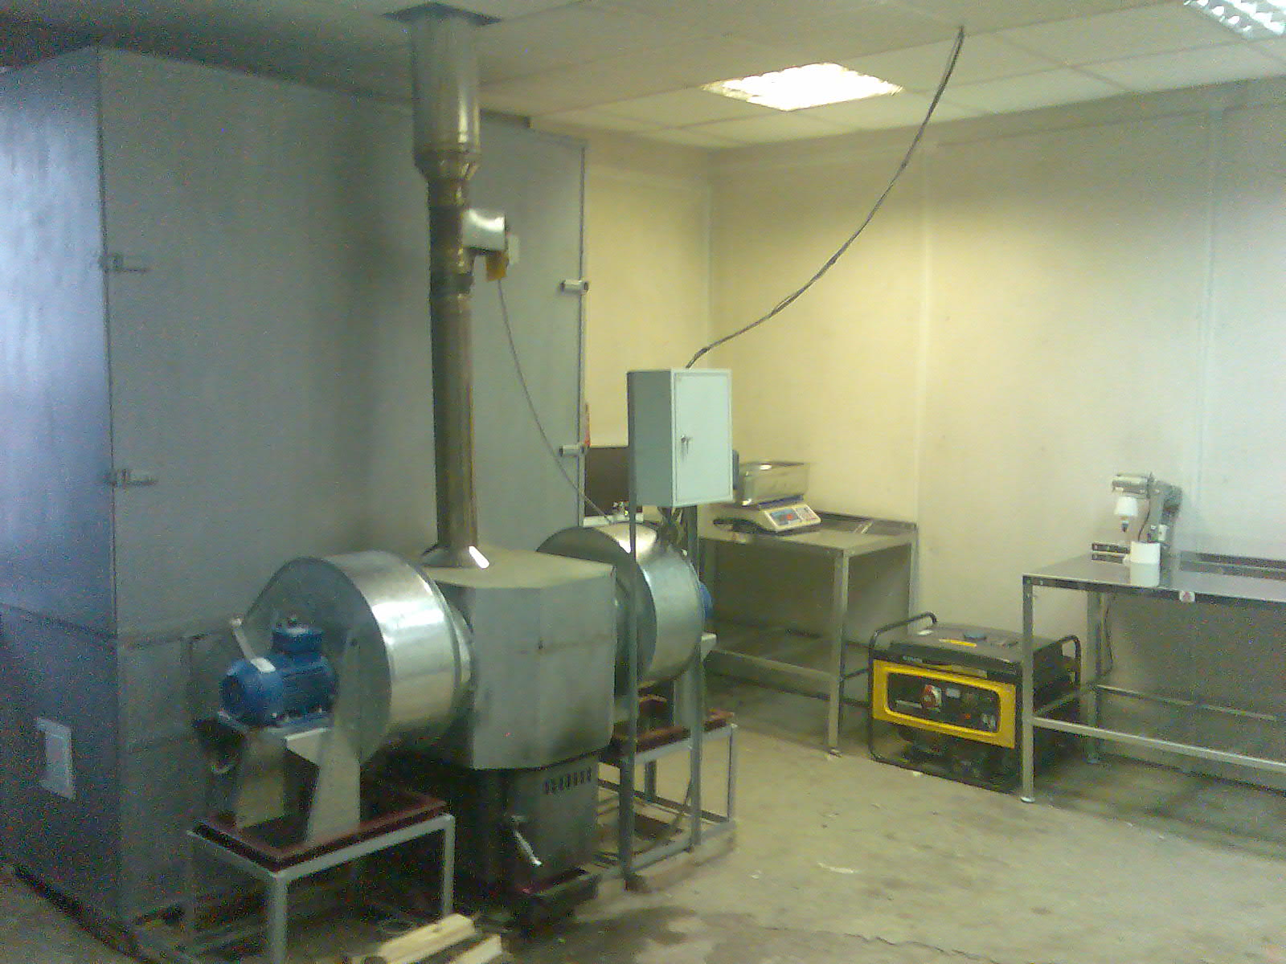
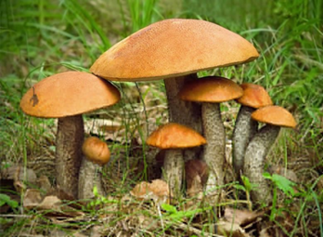
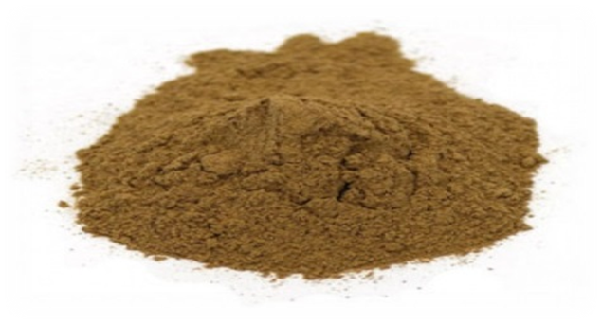
Bicameral standalone Module for High Performance Processing of fresh Mushrooms (MHPPM)
9

Slide 10
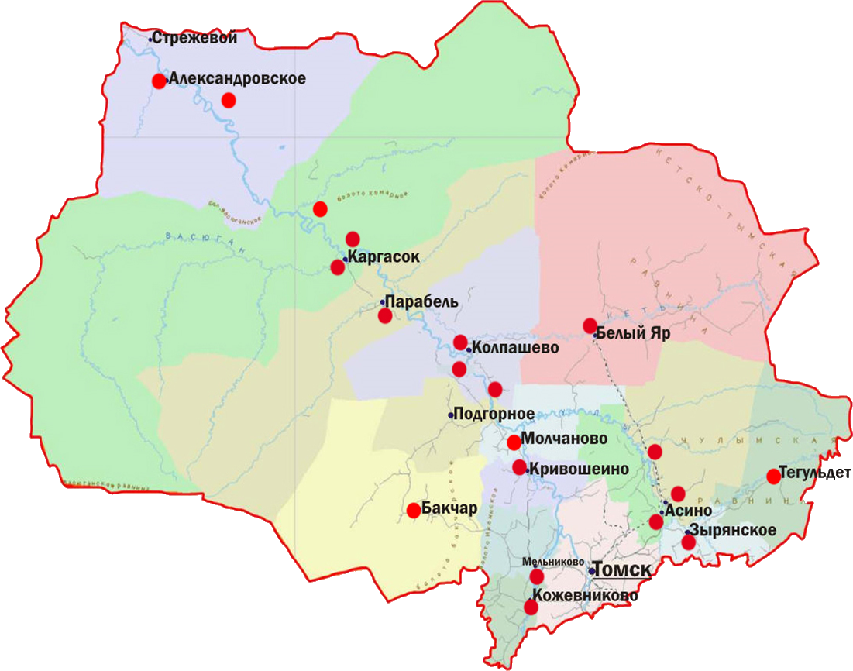
Main centers of mushrooms foraging in the Tomsk region
10

Slide 11
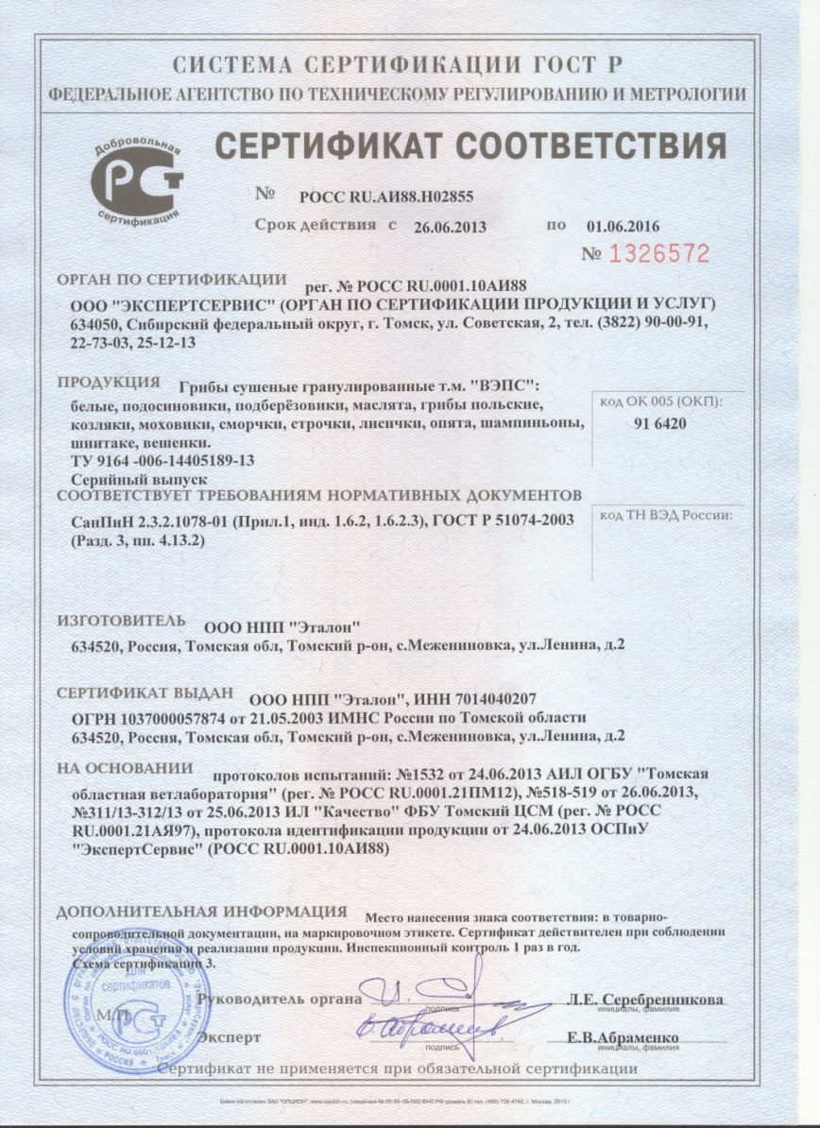
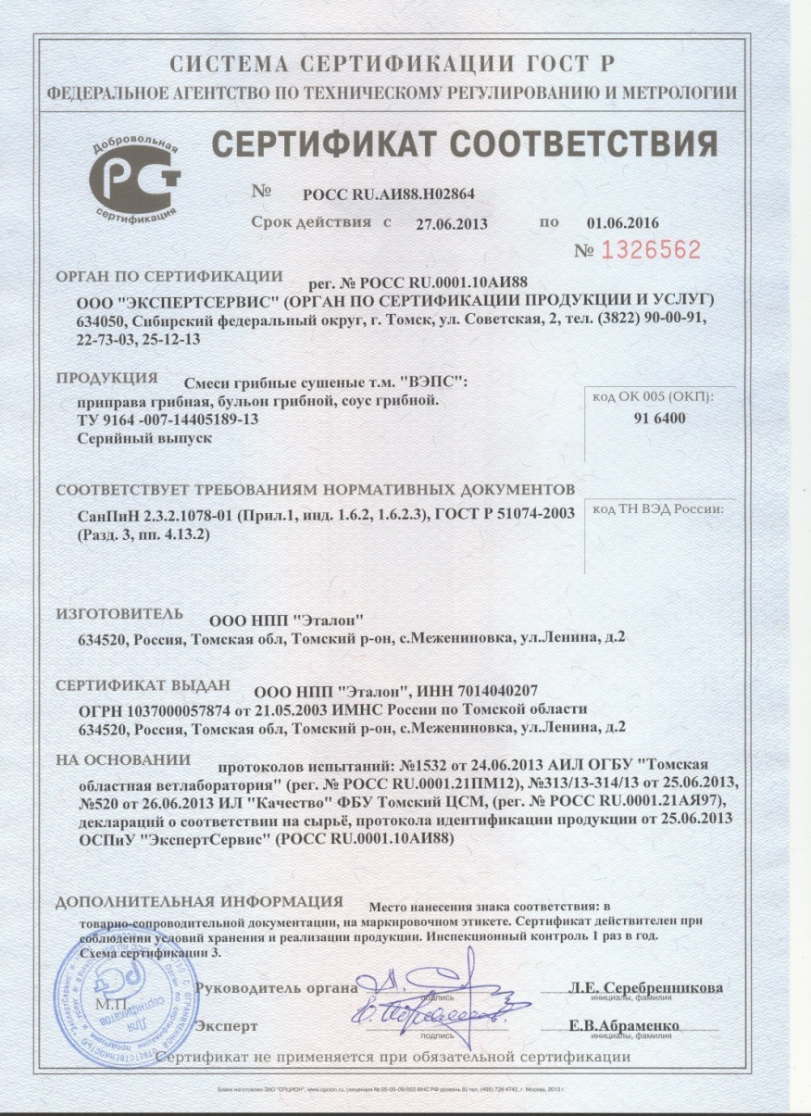
Certificates of conformity SPE «Etalon»
11

Slide 12
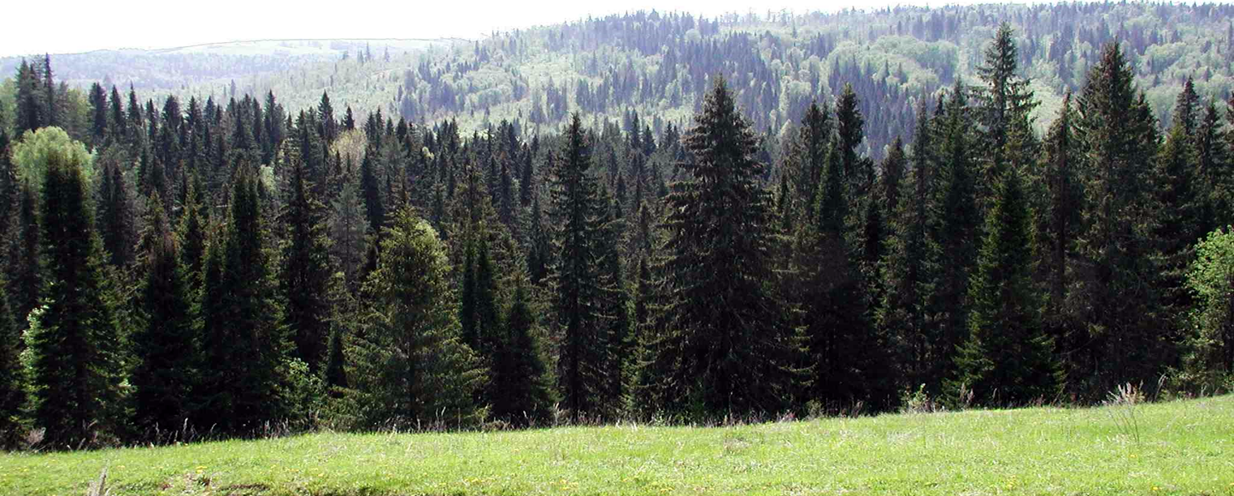
Conclusion
Our project allows the involve underutilized species of mushrooms in trade, increase the production of mushroom spices and blends.
Granular powder more transportable, better kept and can be conveniently packaged. More soluble in cooking.
We look forward to any fruitful cooperation in this area.
634520, Russia, Tomsk region, Mezheninovka village, Lenin st. 2 E-mail: bioetalon@mail.ru, Telephone: (3822) 59-12-86, 8-913-829-1286
12

